Slide 1
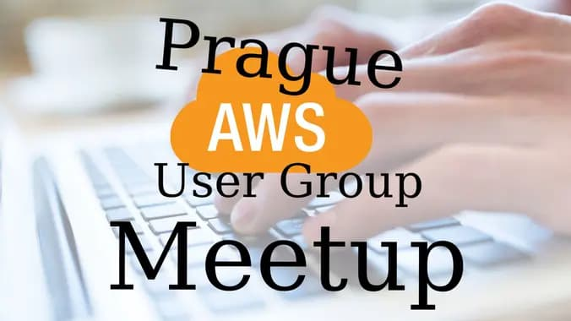

Slide 2
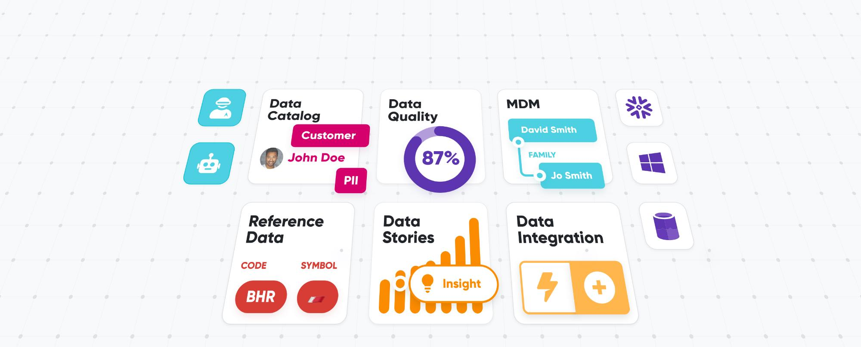
Ataccama ONE - Unified Data Management Platform
Gartner & Forrester Recognition
Bain Capital 150M USD
investment
450+ Global Customers
Notes:
I’m from Ataccama, from Prague, Czech republic
Ataccama is czech-canadian company who makes a unified data management platform
We have been recognized by Gartner and Forrester. We have several hundres of customers all around the world….
And recently we received one of the biggest investment in history of czech republic from Bain capital, more than 150M USD

Slide 3
Program:
Data Science Product Development for Internal Businesses with AWS and Python by Sheikh Alam (Data Science Product Developer at Novartis)
Cloud Governance at scale with AWS Control Tower and Terraform by Martin Damovsky (Cloud Governance Lead at Ataccama)

Slide 4

Special guest from AWS!
Pavol Sojak
AWS Account Manager - Business Development

Slide 5
ENJOY the meetup

Slide 6
&

Slide 7
Cloud Governance at scale with AWS Control Tower and Terraform
Martin Damovsky
Cloud Governance Lead
Ataccama

Slide 8
AWS Control Tower
The easiest self-service solution to automate the setup of new AWS multi-account environments
AWS Managed Services (AMS) version of multi-account environment
Deployment of AWS best-practice blueprints and guardrails
An AWS service, offering automated account creation based on AWS best practices
Dashboard for monitoring compliance status

Slide 9












Landing zone provisioned by AWS Control Tower
Management account
AWS Control Tower
AWS Organizations
AWS SSO
AWS CloudFormation
StackSets
AWS Service Catalog
(Account Factory)
Security OU
Sandbox OU
AWS SSO directory
Log archive account
Audit account
Provisioned accounts
Account baseline
Account baseline
Security cross-account roles
Account baseline
Centralized AWS CloudTrail and AWS Config logs
Security notifications
AWS Config aggregator
Network baseline

Slide 10
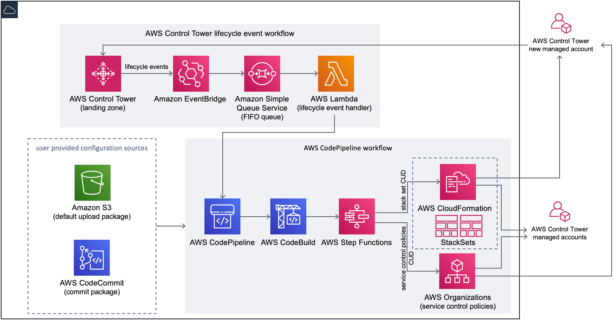
Customizations for AWS Control Tower

Slide 11
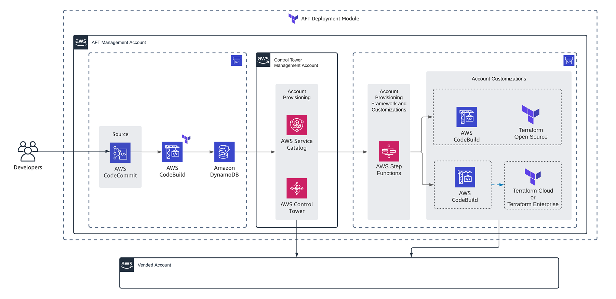
AWS Control Tower Account Factory for Terraform

Slide 12
Motivation
Notes:
Allright!
Let’s imagine you join company who has 25 AWS accounts and soon will have 50 of aws account.
This was my reality one year go….in next half an hour you will see how we were able to manage over hundreds of aws accounts
you will see a real examples from our configuration

Slide 13
Ataccama ONE - Unified Data Management Platform
Gartner & Forrester Recognition
450+ Global Customers
Notes:
I’m from Ataccama, from Prague, Czech republic
Ataccama is czech-canadian company who makes a unified data management platform
We have been recognized by Gartner and Forrester. We have several hundres of customers all around the world….
And recently we received one of the biggest investment in history of czech republic from Bain capital, more than 150M USD

Slide 14
Why?
Engineering: Ataccama product is single tenant
Business: We want to have thousands of customers in cloud
Security: We must completely separate customers
AWS: Separate workloads using accounts
Notes:
Every presentation should start with WHY
Today it's about multi account management...so Why I am here….why we need to have multiple accounts? ….why we cannot use just one?
everything started in onprem world
hey martin, security guys told me...
After discussion with AWS they told me to use multiple accounts

Slide 15
New Customer = new AWS account
Notes:
with 100 customers we will have 100 accounts

Slide 16
Challenge accepted!
Notes:
so, now you might understand our situation a bit...Let's go to the actual challenge

Slide 17



We wanted to configure 3 services at the begining
IAM users, roles, policies
GuardDuty settings
Security Hub Settings
…in all AWS accounts
…in ~10 AWS regions

Slide 18
How to configure 100+ AWS accounts with regional services and not get mad?!

Slide 19

How many AWS accounts do you have?

Slide 20
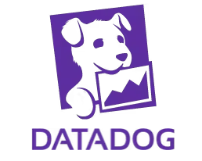
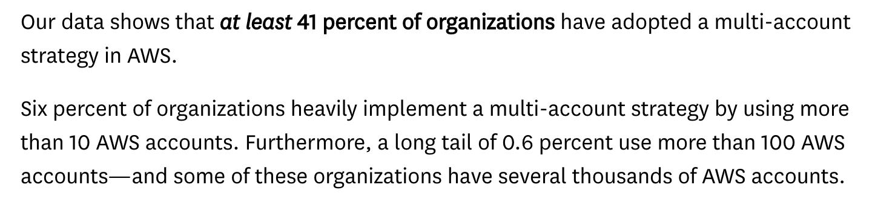
State of AWS Security
October 2022
https://www.datadoghq.com/state-of-aws-security/

Slide 21
AFT
Notes:
in previous chapter I talked about the challenge of multi account strategy in AWS
and now let's talk about solution for that challenge!

Slide 22

One Year ago…
…one powerful tool has been born!
Notes:
One year ago aws released very powerful tool….but I was very sceptical from the beginning….I didn’t like the tool and its complexity
I was saying to Iaroslav: “Hey Iaroslav….I don’t want to built another International Space Station….”
What’s behind the magic

Slide 23
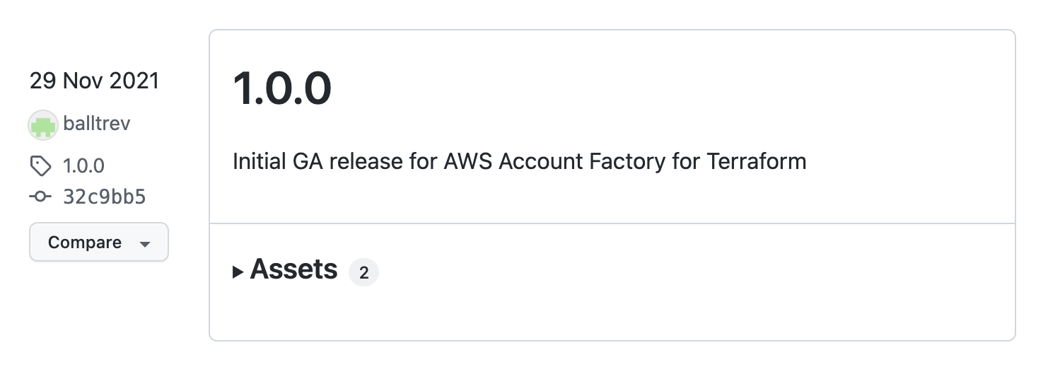

AWS Control Tower Account Factory for Terraform (AFT)

Slide 24
What is AFT

Slide 25
Solution that enables you to create / update AWS accounts with your predefined customizations

Slide 26

5 steps to make it working
Create a new AWS account for AFT
Git clone from GitHub
Set up a few input variables
terraform apply
Go for coffee for next 30 min

Slide 27



The main principle of AFT
git push
Trigger the CodePipeline
Do the job
Developers
CodeCommit
CodeBuild
Git Approval WF
Notes:
Auditing – merge requests approval

Slide 28
Account requests described by terraform
module ”sandbox-for-damovsky" {
source = "./modules/aft-account-request"
control_tower_parameters = {
AccountEmail = ”martin.Damovsky@ataccama.com"
AccountName = ”My Sandbox Account"
ManagedOrganizationalUnit = ”Sandboxes”
}
account_customizations_name = ”dev-sandboxes"
}

Slide 29
Account creation process in AFT - output
A new AWS Account has been created
A new CodePipeline for this AWS account has been created
Recently created pipeline is being started

Slide 30
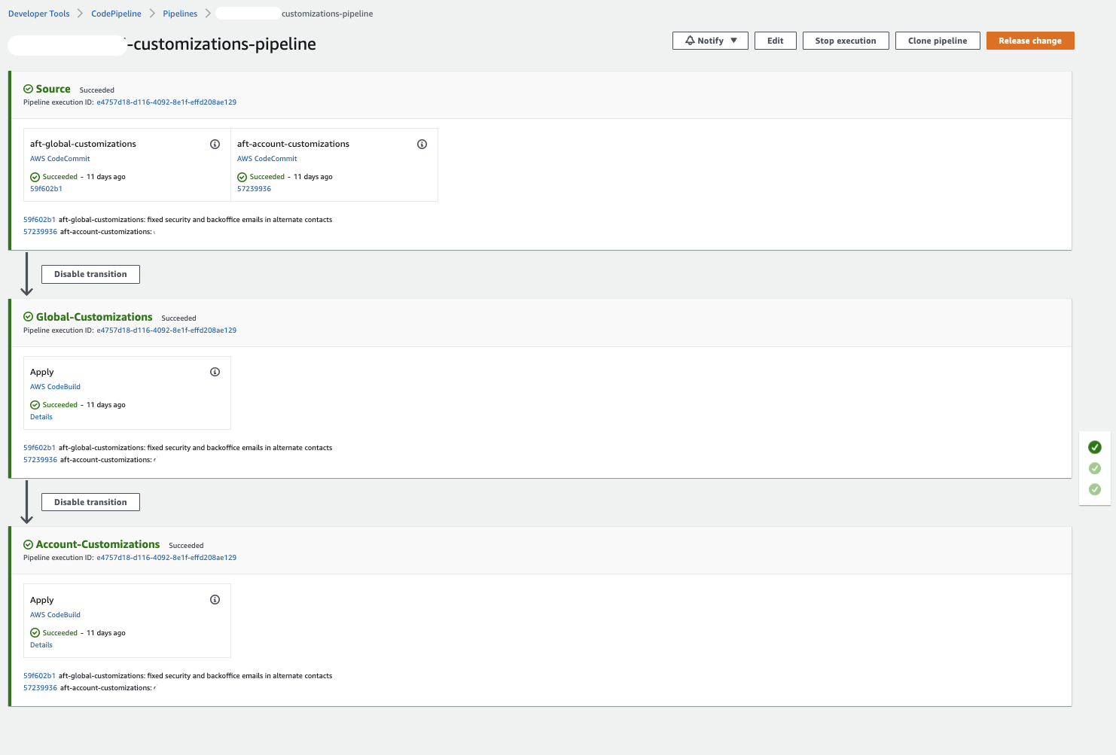
Every pipeline includes…

Slide 31
2 repositories

Slide 32
Global Customization

Slide 33
Account Customization

Slide 34
Let’s see Global Customization Pipeline!

Slide 35
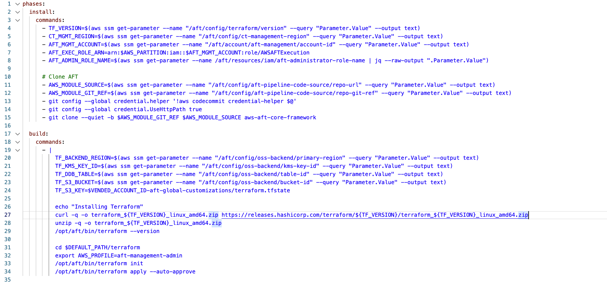

Slide 36
What we use AFT for?
Notes:
now you understand what is AFT...and its main principle...
in a next few slides I will talk about AFT in Attaccama

Slide 37

Ataccama use case – different AWS workloads
Customer
Internal IT
Engineering
Sandbox
More secure
Less secure

Slide 38
Solutions and adjustments
Notes:
in previous two slides I described our approach to AFT from high level...
now let's start with that fun...with a real examples

Slide 39
Alternate contacts
resource "aws_account_alternate_contact" "contacts" {
alternate_contact_type = "SECURITY"
name = "CSIRT TEAM"
title = "CSIRT TEAM"
email_address = "xxx@ataccama.com"
phone_number = "+420xxxx"
}
basic
medium
advanced

Slide 40
EBS default encryption
resource "aws_ebs_encryption_by_default" "ebsEncryption" {
enabled = true
}
basic
medium
advanced

Slide 41
HW MFA Root Security Hub Control
resource "aws_securityhub_standards_control" "ensure_hw_mfa_for_root_enabled" {
standards_control_arn = "…/xxxx/v/1.0.0/IAM.6"
control_status = "DISABLED"
disabled_reason = "disabled via AFT as ROOT user is disabled by SCP"
}
basic
medium
advanced

Slide 42
Local development (for debug purposes)
Get the inspiration from the pipeline itself
src: modules/aft-customizations/buildspecs
basic
medium
advanced
Notes:
copy settings from pipelines like
ENV variables
assume roles

Slide 43
Multi Region support
Ataccama supports 15 regions
AFT and TF supports multiple TF Providers
basic
medium
advanced

Slide 44
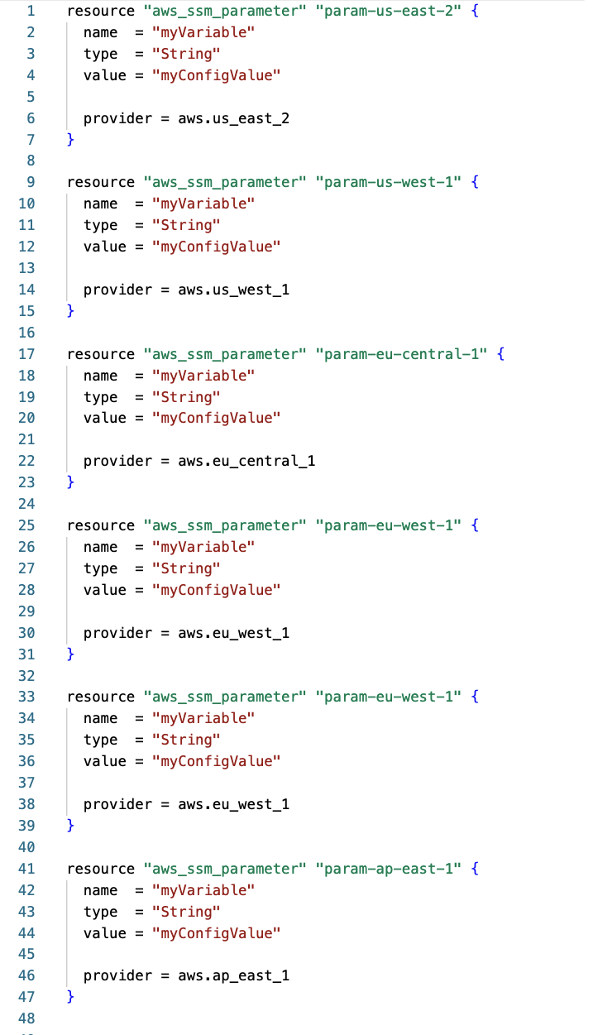
Multi Region support
TF code with multiple TF providers is not “clean code”

Slide 45
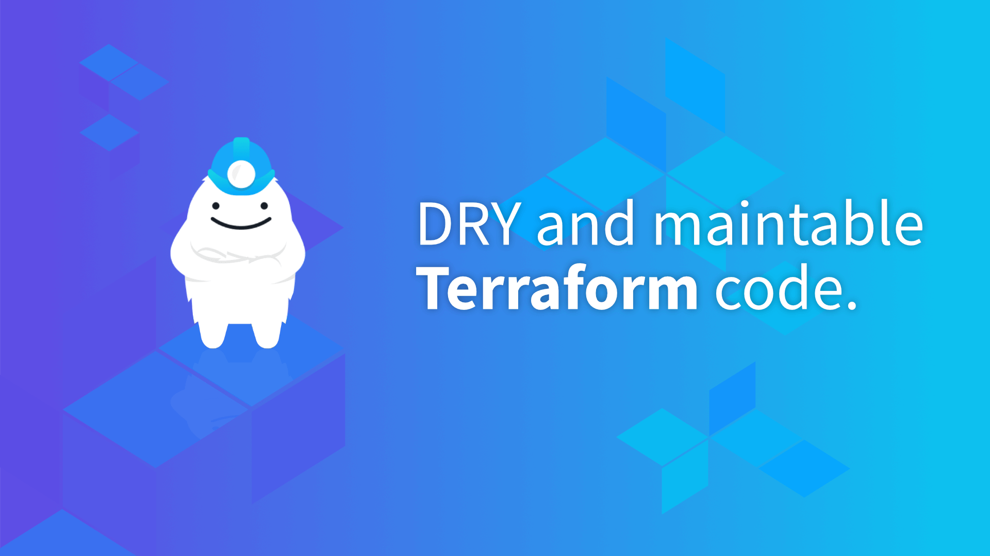
Multi Region support with Terragrunt
We decided to replace Terraform by Terragrunt

Slide 46
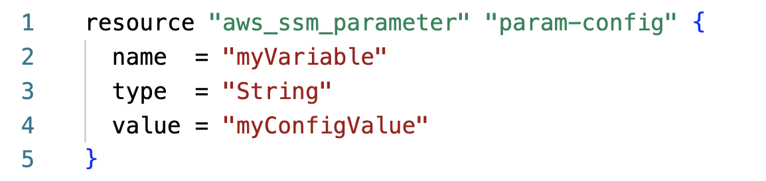
Multi Region support with Terragrunt
/modules/ssm/ssm.tf

Slide 47
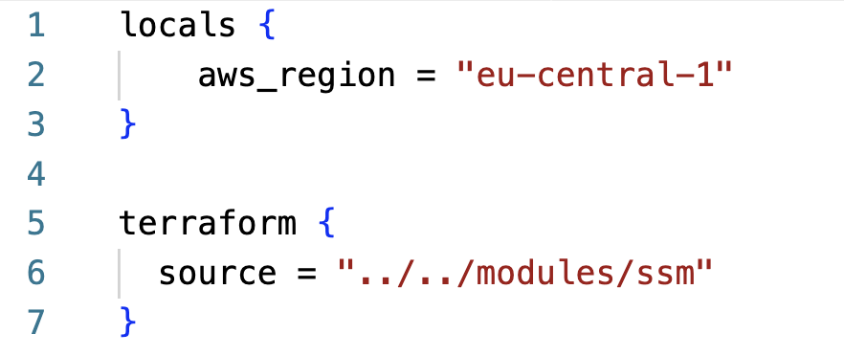
Multi Region support with Terragrunt
/regions/eu-central-1/terragrunt.hcl
/us-east-1/terragrunt.hcl
/eu-west-1/terragrunt.hcl

Slide 48
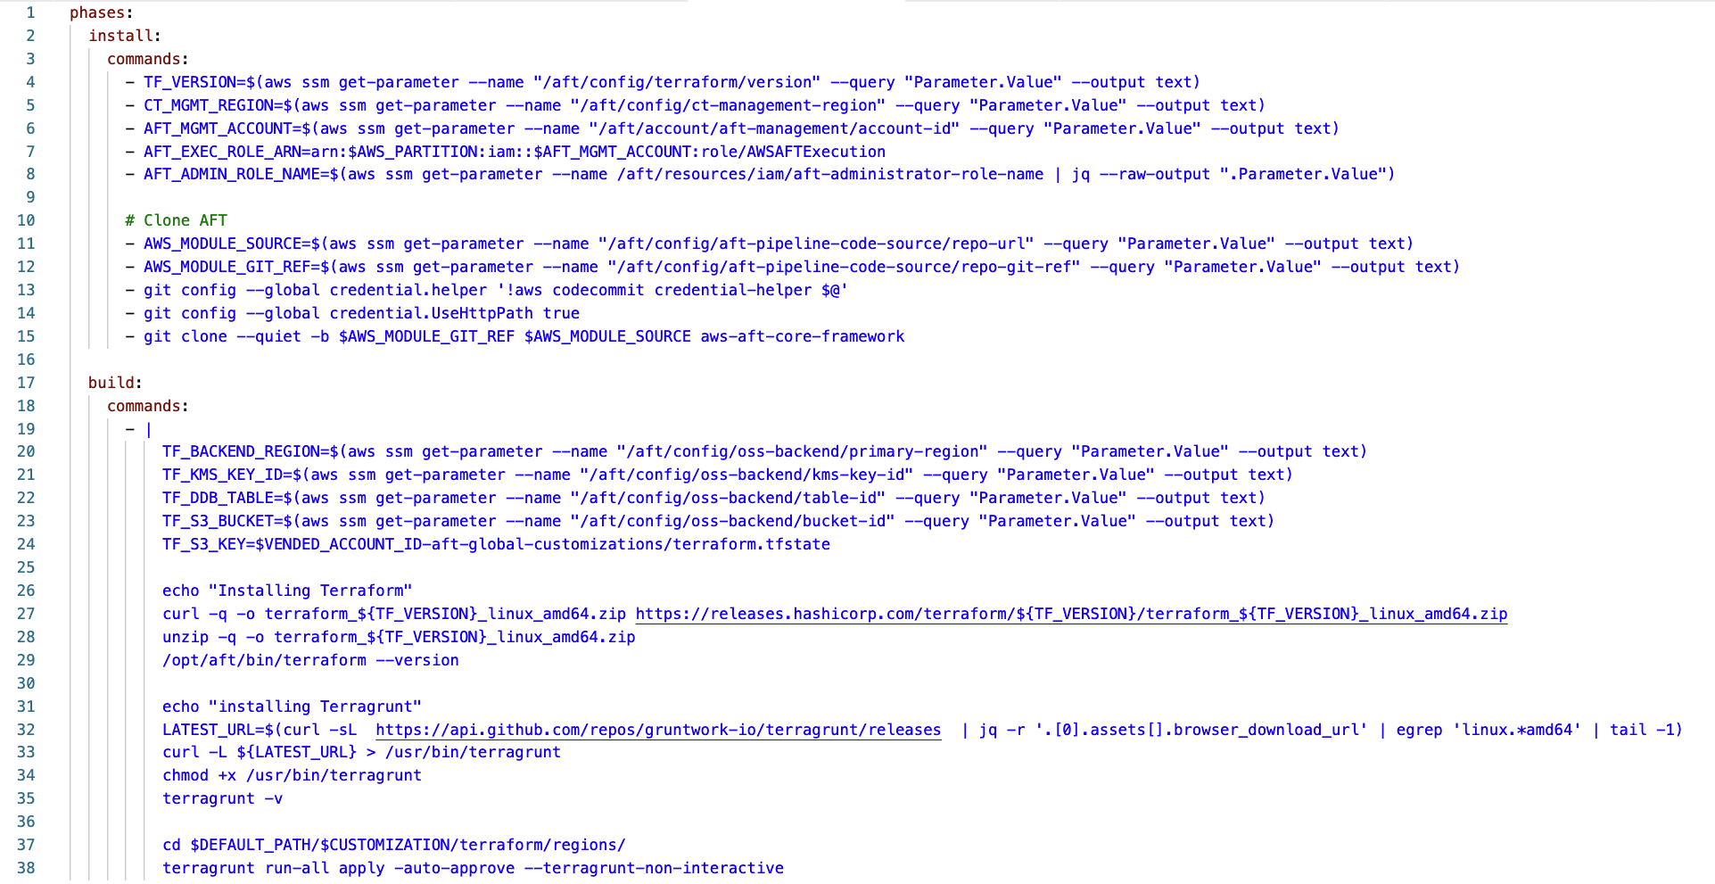
Multi Region support with Terragrunt
Ataccama-aft-fork/modules/aft-customizations/buildspecs
We decided to replace Terraform by Terragrunt
Pros
CONS

Slide 49
Multi Region support with Terragrunt
Ataccama-aft-fork/modules/aft-customizations/buildspecs

Slide 50
Security

Slide 51

AFT is not a toy for kids!
AFT has access to EVERY account
via role with policy iam::aws:policy/AdministratorAccess

Slide 52

Security recommendations
Secure access to your AFT account
Regularly update your AFT
Be careful with 3rd party TF modules
Follow @damovsky

Slide 53
Costs?

Slide 54
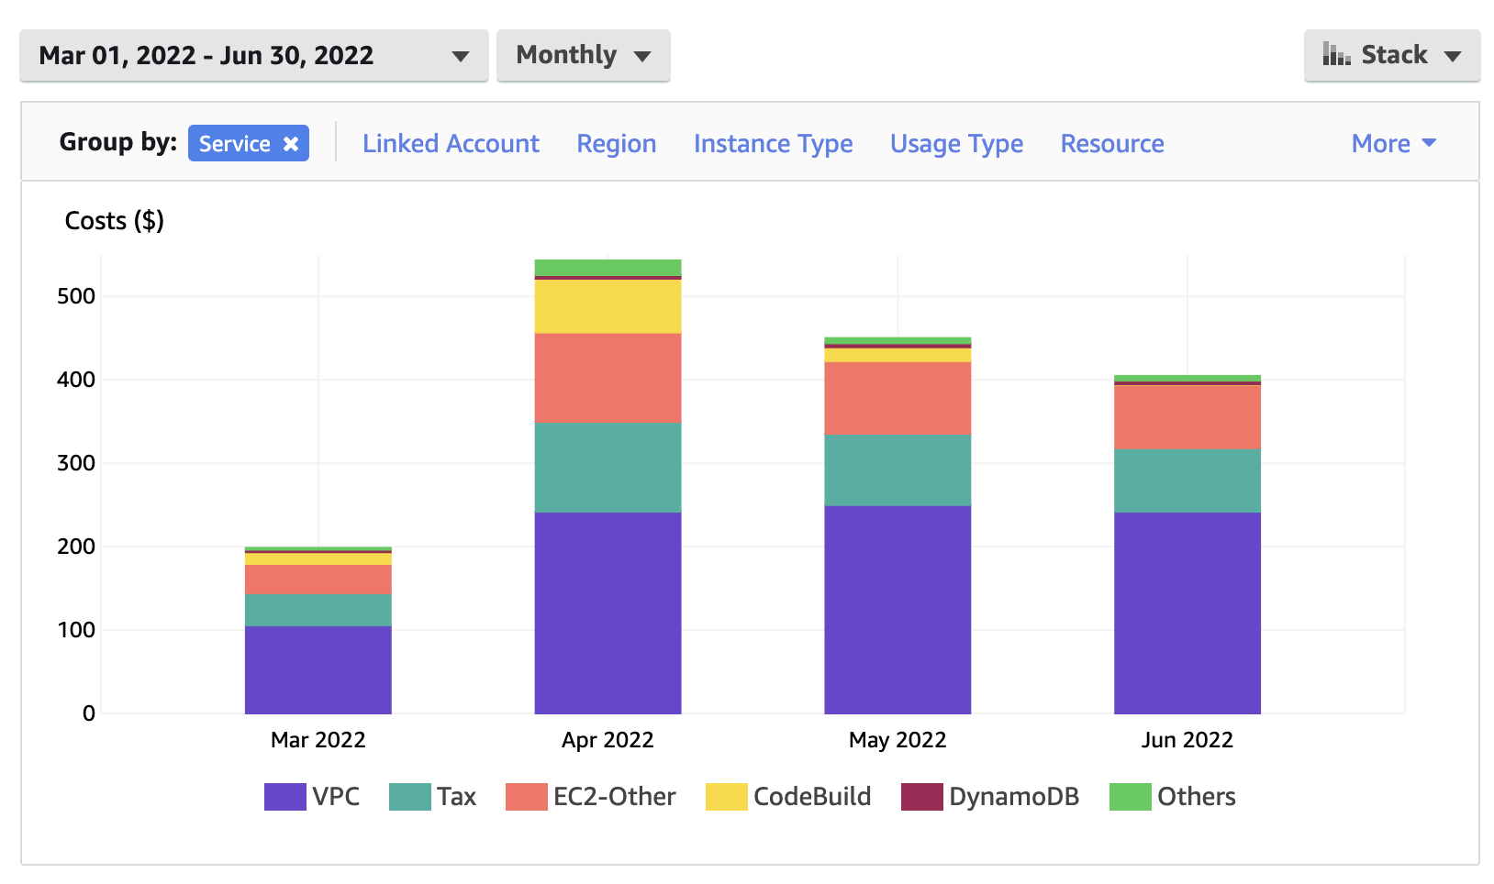
You pay for services used by AFT

Slide 55
Q: How to configure 100+ AWS accounts with regional services and not get mad?!
A: Use AFT

Slide 56
Learning materials

Slide 57
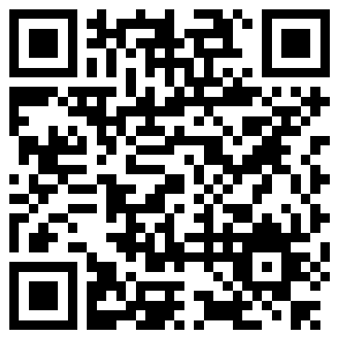
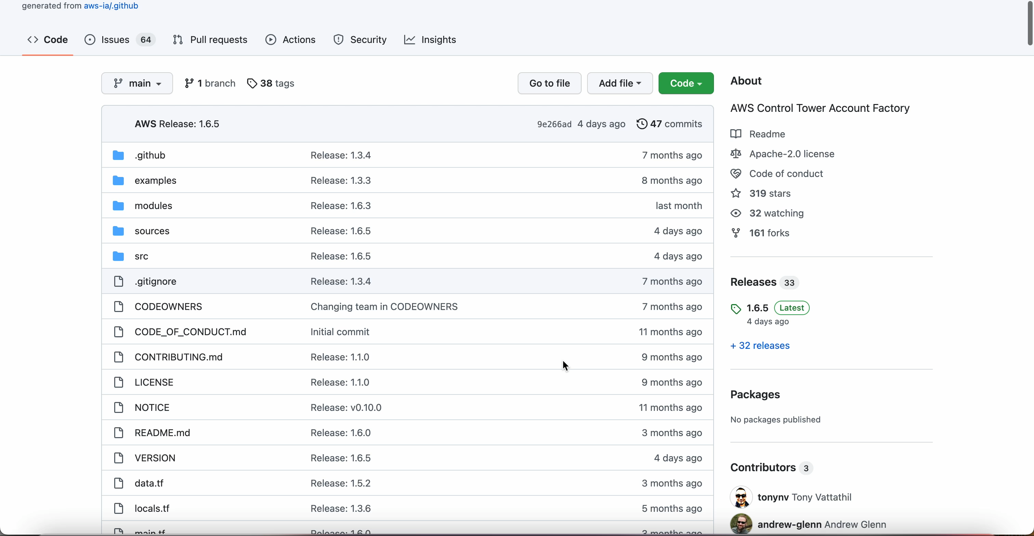
AFT GitHub
https://github.com/aws-ia/terraform-aws-control_tower_account_factory

Slide 58
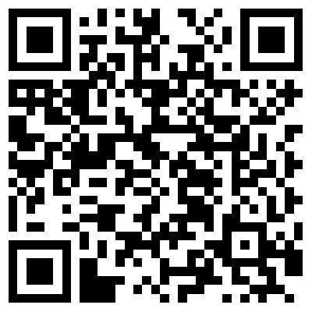
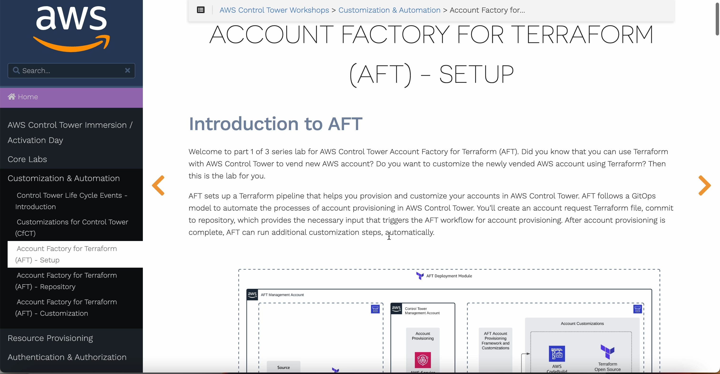
AWS Labs
AWS Control Tower Immersion days
https://controltower.aws-management.tools/automation/aft_setup/

Slide 59
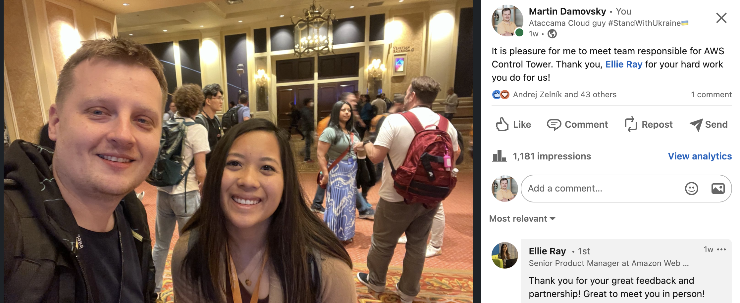
Meeting AWS Control Tower Team at AWS re:Invent 2022

Slide 60
Martin Damovsky
Martin.damovsky@ataccama.com
@damovsky

Slide 61
“AFT is one of the most powerful tool I’ve seen in AWS”
People like devs, auditors, and security will love it!
@damovsky

